Slide 1
Why This Study?
Our Research
Findings
When Mission and Market Forces Intersect:
A study of NAIS member schools navigating an economic recession
Recommendations
Discussion
Matt Rush, Assistant Head of School
Cannon School, NC
Barry Gilmore, Middle School Head
Hutchison School

Slide 2
Why This Study?
Our Project Question
Our Research
How did the recession impact financial processes and operations
at independent schools?
Findings
Recommendations
Discussion

Slide 3
Survey
(Heads and Business Managers)
Why This Study?
NAIS Database
School Site Visits
Our Research
Findings
1,300 schools
2,661 emails
Recommendations
Matched data
2005-2010
988 responses (37%)
Discussion
1,149 schools
Enrollment, tuition, salary, etc.
School responses and decisions

Slide 4
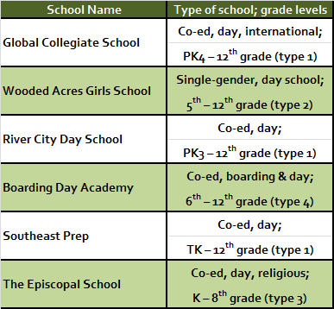
Why This Study?
School Site Visits
Our Research
Findings
Recommendations
Discussion
Notes:
TYPES?

Slide 5
How Far South is South?
Initial Planning for the Recession
Waiting Another Year
Unanticipated Enrollment Trends
Why This Study?
Our Research
Leadership
Community
Continued Growth
Findings
Recommendations
Building on a Solid Foundation
Where Schools Stayed the Course
Doing More
With Less
Where Schools Made Adjustments
Discussion

Slide 6
1. Conservative planning
How Far South is South?
Initial Planning for the Recession
“When it looked like things were heading south, I don’t think any of us knew exactly how far south ‘south’ was, or how fast.”
(Business Manager, Global Collegiate School)
Why This Study?
2. Keeping families on site
Our Research
Findings
Recommendations
Discussion

Slide 7
Conservative planning
Why This Study?
“We did budget for the year after the recession as if we were going to lose 20 students. We also created a third budget asking everyone who had a budget, ‘Where can you cut?’ We asked to cut back 2-3% overall and then we said, if you could cut 5%, where would you do it?”
(Business Manager, Wooded Acres)
Our Research
Findings
Recommendations
Discussion
INITIAL PLANNING

Slide 8
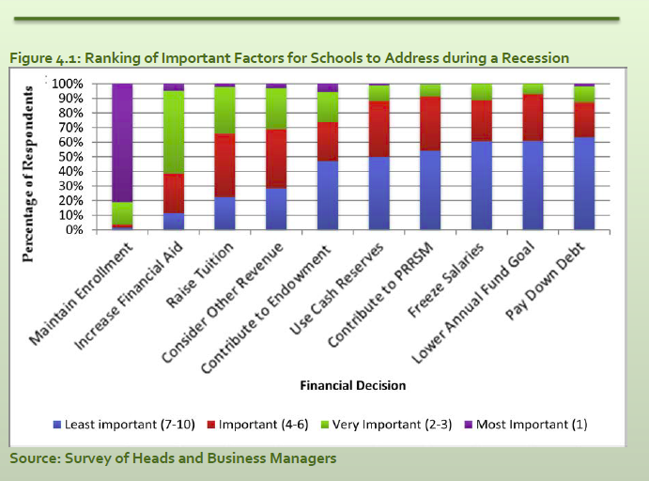
Keeping families on site
Why This Study?
Our Research
Findings
Recommendations
Discussion
INITIAL PLANNING

Slide 9
1. Extended admissions season
Waiting Another Year
Unanticipated Enrollment Trends
Why This Study?
2. Decrease at entry grade levels
“More parents chose to wait a year due to the public schools in the area and the recession.”
(Parent, Southeast Prep)
3. Increase at other grade levels
Our Research
Findings
Recommendations
Discussion

Slide 10
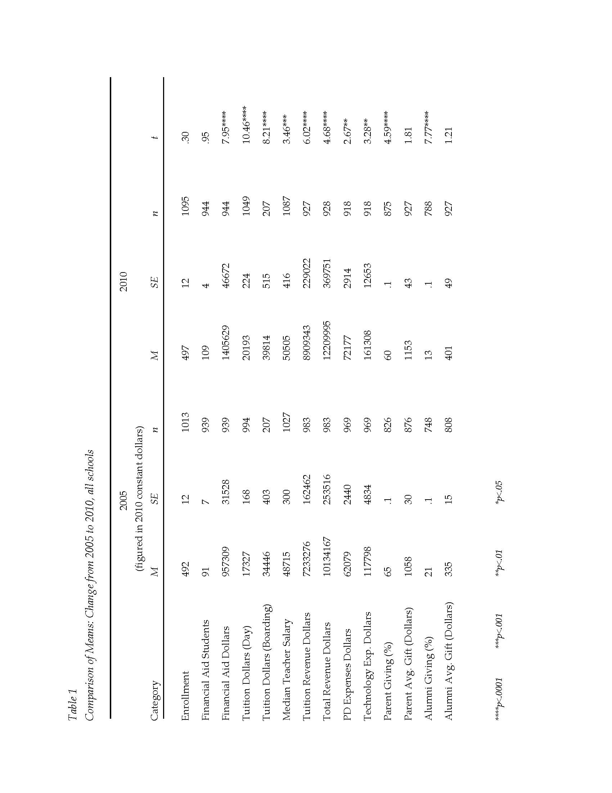

Slide 11
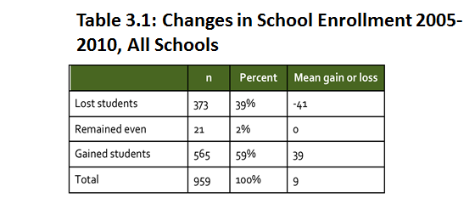
Overall enrollment trends
Why This Study?
Our Research
Findings
Recommendations
Discussion
ENROLLMENT TRENDS
Notes:
SOURCE?

Slide 12
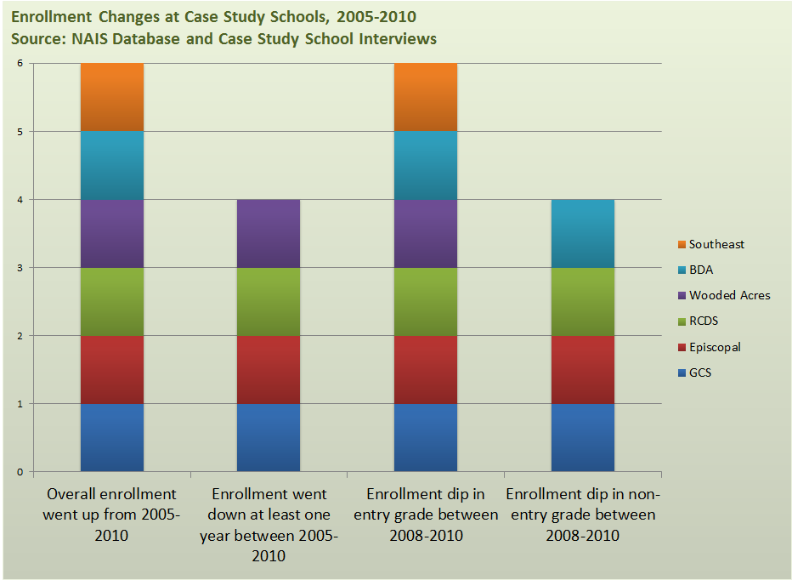
Why This Study?
Our Research
Findings
Recommendations
Discussion
ENROLLMENT TRENDS

Slide 13
1. No program cuts
Building on a Solid Foundation
Where Schools Stayed the Course
“The education and programs are most important to people here. They are the foundation, not any new buildings themselves.”
(Academic Dean, Boarding Day Academy)
Why This Study?
2. Small cuts in operations
3. Similar annual giving goals
Our Research
4. Continued capital goals
Findings
5. Moderate attention to endowment
Recommendations
Discussion

Slide 14
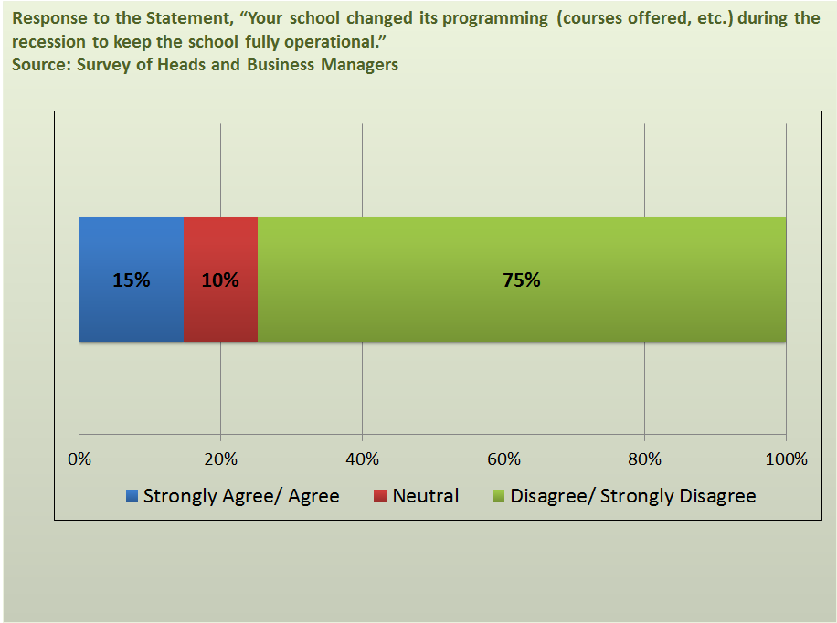
No program cuts
Why This Study?
Our Research
Findings
Recommendations
Discussion
WHERE SCHOOLS STAYED THE COURSE

Slide 15
Small cuts in operations
Why This Study?
“We looked at every pencil that we had to buy and we realized in the process that we can really do with a lot less if we have to.”
(Teacher, GCS)
Our Research
Findings
Recommendations
Discussion
WHERE SCHOOLS STAYED THE COURSE

Slide 16
Similar annual giving goals
Why This Study?
No statistically significant difference in total giving dollars (parents or alumni)
Our Research
Findings
Percentage of giving, 2005-2010:
Parents: -5% (p<.0001)
Alums: -8% (p<.0001)
Recommendations
Discussion
Takeaway: Fewer parents and alumni gave, but those who did give made larger donations
WHERE SCHOOLS STAYED THE COURSE

Slide 17
Continued capital goals
Why This Study?
Our Research
Only 199 of 967 (20.5%) respondents reported that they had to postpone a capital campaign as a financial adjustment since the fall of 2008.
Findings
Recommendations
Discussion
WHERE SCHOOLS STAYED THE COURSE

Slide 18
1. Increased financial aid
“We’re trying to do more with less…to find ways to create a meaningful, exciting experience for school children that made kids and families want to stay.”
(Head of School, The Episcopal School)
2. Modest salary increases
Doing More With Less
Where Schools Made Adjustments
Why This Study?
3. Modest tuition increases
Our Research
4. Deferred physical plant maintenance
Findings
5. Increased online services
Recommendations
6. Re-examined marketing
Discussion
7. New constituencies
8. Re-examined parent organizations
9. Increased accountability

Slide 20
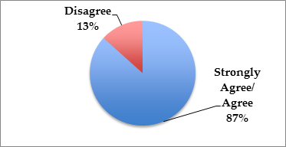
Increased financial aid
Why This Study?
Our Research
Findings
Recommendations
Discussion
Source: Survey of Heads and Business Managers
Response to the statement, “Over the past three years, the school saw increased demands for financial aid from formerly full paying families”
WHERE SCHOOLS MADE ADJUSTMENTS

Slide 21
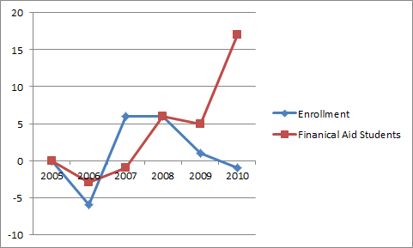
Increased financial aid
Why This Study?
Our Research
Findings
Recommendations
Discussion
Source: NAIS Database
Mean change in FA students:
91 (2005), 109 (2010), p<.05
WHERE SCHOOLS MADE ADJUSTMENTS
Notes:
Axis labels and source?

Slide 22
Increased tuition
Why This Study?
Source: Survey of Heads and Business Managers
Our Research
Findings
Recommendations
Discussion
Rank of Tuition
Among Important Factors for a School
to Address During the Recession
WHERE SCHOOLS MADE ADJUSTMENTS

Slide 23
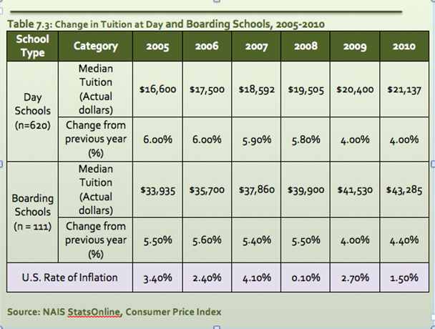
Increased tuition
Why This Study?
Our Research
Findings
Recommendations
Discussion
WHERE SCHOOLS MADE ADJUSTMENTS

Slide 24
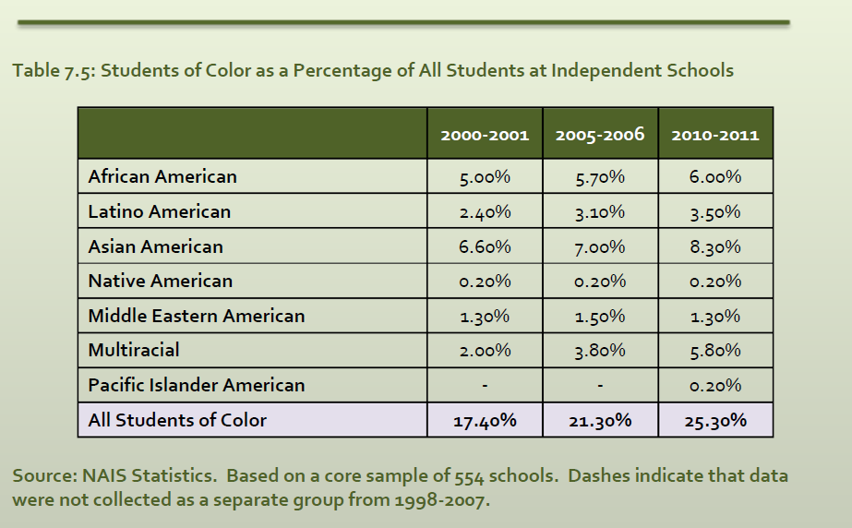
New constituencies
Why This Study?
Our Research
Findings
Recommendations
Discussion
WHERE SCHOOLS MADE ADJUSTMENTS

Slide 25
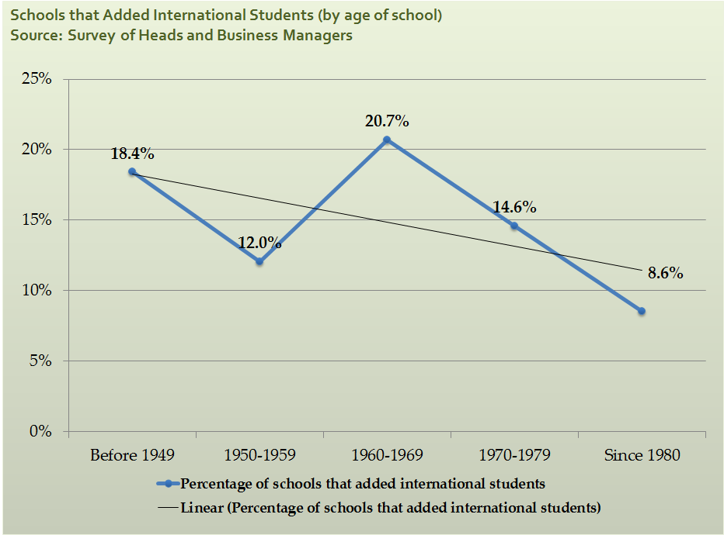
New constituencies
Why This Study?
Our Research
Findings
Recommendations
Discussion
WHERE SCHOOLS MADE ADJUSTMENTS

Slide 26
New constituencies
Why This Study?
“The question that one might ask is whether we are compromising the input, the quality of students we are getting…but we have another question we ask ourselves in terms of inclusion—what kind of differentiated public we want at the school.”
(Division Head, GCS)
Our Research
Findings
Recommendations
Discussion
WHERE SCHOOLS MADE ADJUSTMENTS

Slide 27
“We were going to be a calm oasis in a storm…I spent the fall talking about the fact that we want to create an oasis for our children.”
(Head of School, Southeast Prep)
Leadership
Community
Why This Study?
Continued Growth
Our Research
Findings
“The administrative team gets along well. But they're also leading in a direction that works for all of us. Everything is more purpose driven than it was.”
(Teacher, RCDS)
Recommendations
Discussion
WHERE SCHOOLS MADE ADJUSTMENTS

Slide 28
Leadership: A Calm Oasis in a Storm
Why This Study?
Our Research
Relationships matter
Findings
In tough times, leaders become stewards
Recommendations
Leaders make partners out of teachers
Discussion
WHERE SCHOOLS MADE ADJUSTMENTS

Slide 29
“The community is really something that we are willing to invest in in order to maintain because that’s the strength of the school…it is the strength of the school.”
(Director of Advancement, Global Collegiate School)
Leadership
Community
Why This Study?
Continued Growth
Our Research
Findings
“The school is at a watershed moment, where we are now deciding what our identity is going to be going forth. But the unspoken benefits of our international student program have been tremendous.”
(IB Director, RCDS)
Recommendations
Discussion
WHERE SCHOOLS MADE ADJUSTMENTS

Slide 30
Community: The Strength of the School
Why This Study?
Our Research
Mission driven community: Parent involvement matters
Findings
Market-driven community: Customer service is key
Recommendations
Discussion
WHERE SCHOOLS MADE ADJUSTMENTS

Slide 31
“If you aren’t growing, you’re dying. Our school has taken advantage of the economy and continued to launch capital campaigns, to raise money for ongoing athletic programs, for arts, and land expansion.”
(Assistant Head of Upper School, RCDS)
Leadership
Community
Why This Study?
Continued Growth
Our Research
“Sometimes, the most beautiful flowers grow in manure. Some of the best professional development we can have is from each other. And so it was not that professional development stopped… the way we delivered it stopped. Focusing it to be internal helped the community to grow.”
(Teacher, Global Collegiate School)
Findings
Recommendations
Discussion
WHERE SCHOOLS MADE ADJUSTMENTS

Slide 32
Continued Growth: Growing, Not Dying
Why This Study?
Schools can learn from tough times (organizational learning)
Our Research
Findings
Crisis learning (adaptive change)
Recommendations
Lean thinking (budget lessons)
Discussion
Physical growth (capital campaigns)
Program growth (internal review)
WHERE SCHOOLS MADE ADJUSTMENTS

Slide 33
Why This Study?
Our Research
1. Independent vs. private schools
Findings
Further Research
2. Enrollment shifts
Recommendations
3. Effects of/on teacher retention, teacher workload, class size, life cycle
Discussion

Slide 34
Why This Study?
Our Research
1. Financial aid and admissions
Findings
NAIS
2. Student populations
Recommendations
3. Parent organizations
Discussion
4. Data from non-independent schools
5. More data from independent schools

Slide 35
1. Plan for financial aid and admissions
2. Plan early and prudently
Why This Study?
3. Consider new populations
Our Research
4. Continue to set goals
Findings
5. Invest in social media
NAIS members
6. Watch entry grade enrollment
Recommendations
7. Promote organizational learning
Discussion
8. Benchmark thoughtfully
9. Focus on community
10. Stay true to the mission

Slide 36
Other Aspects of the Study
Why This Study?
Coed and Single-Gender
Our Research
Day and Boarding
Findings
Southeast and Rest of Nation
Recommendations
Age of School
Size differences
Discussion

Slide 37
Why This Study?
Our Research
Findings
Questions?
Recommendations
Discussion

Slide 39
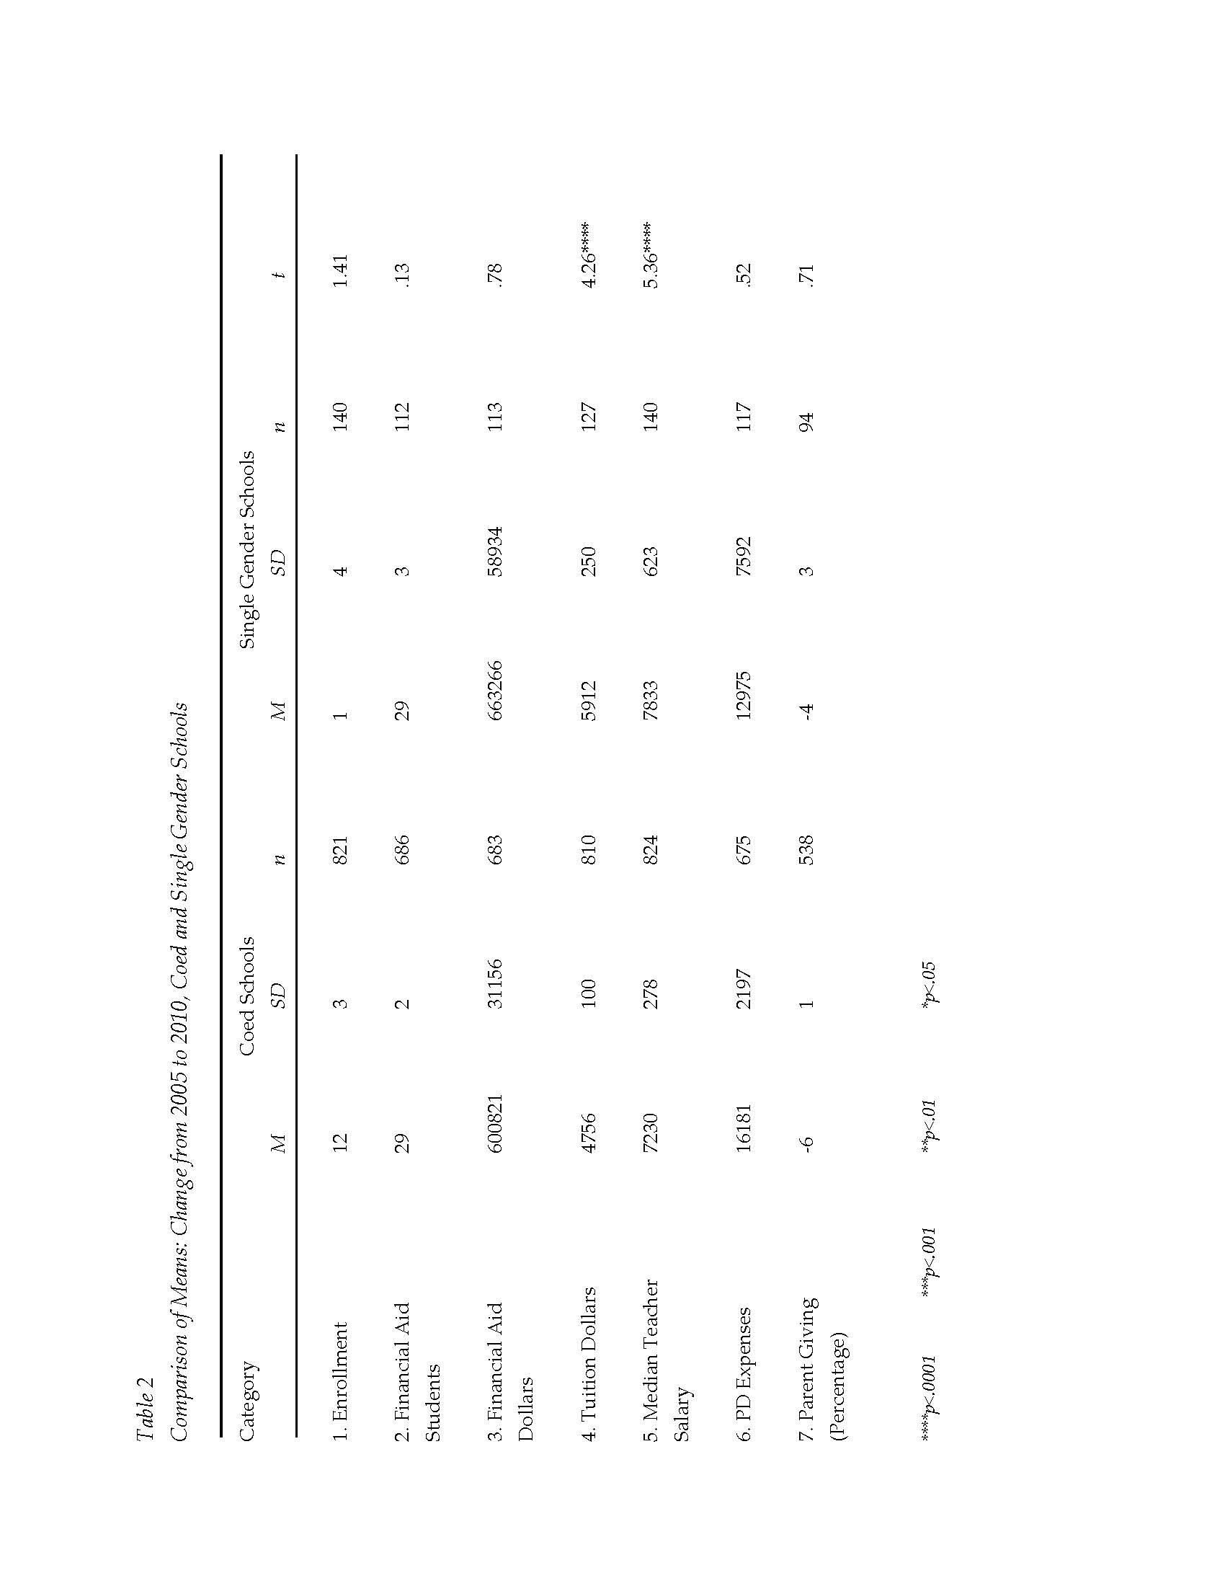

Slide 40
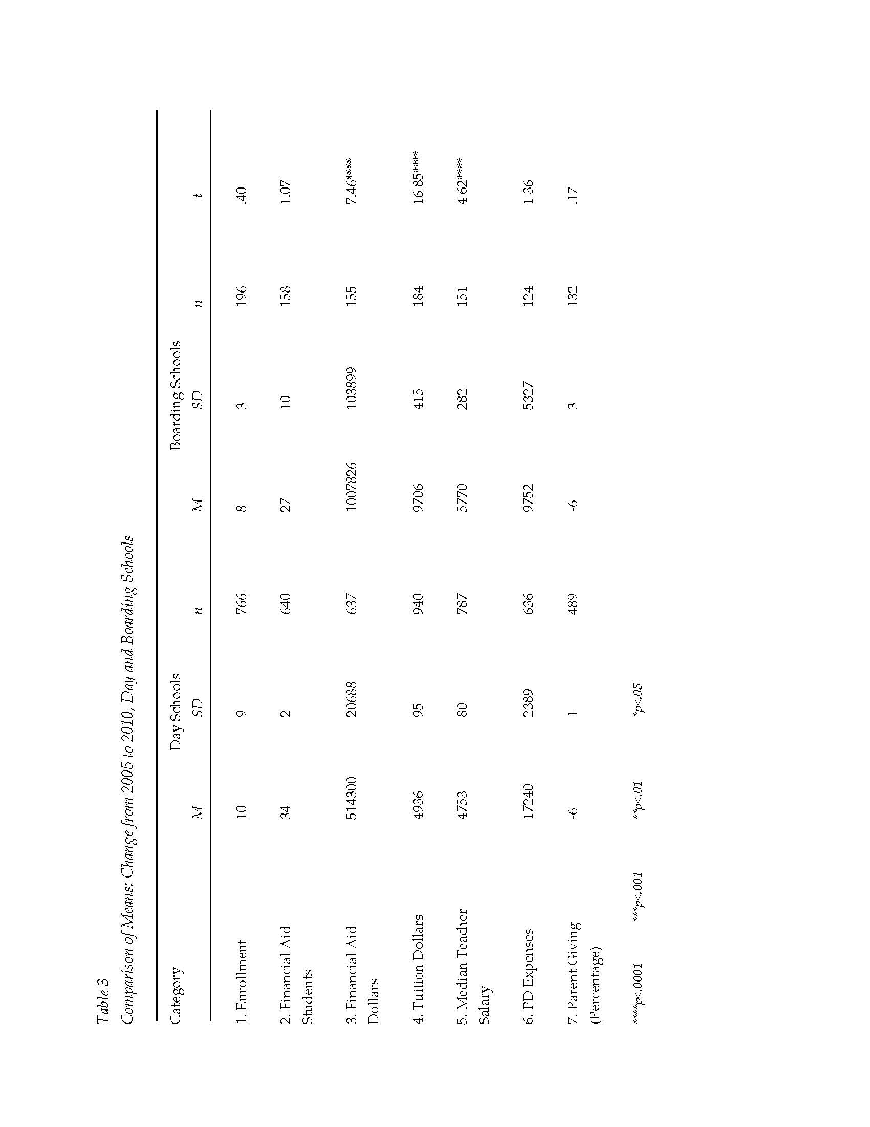

Slide 41
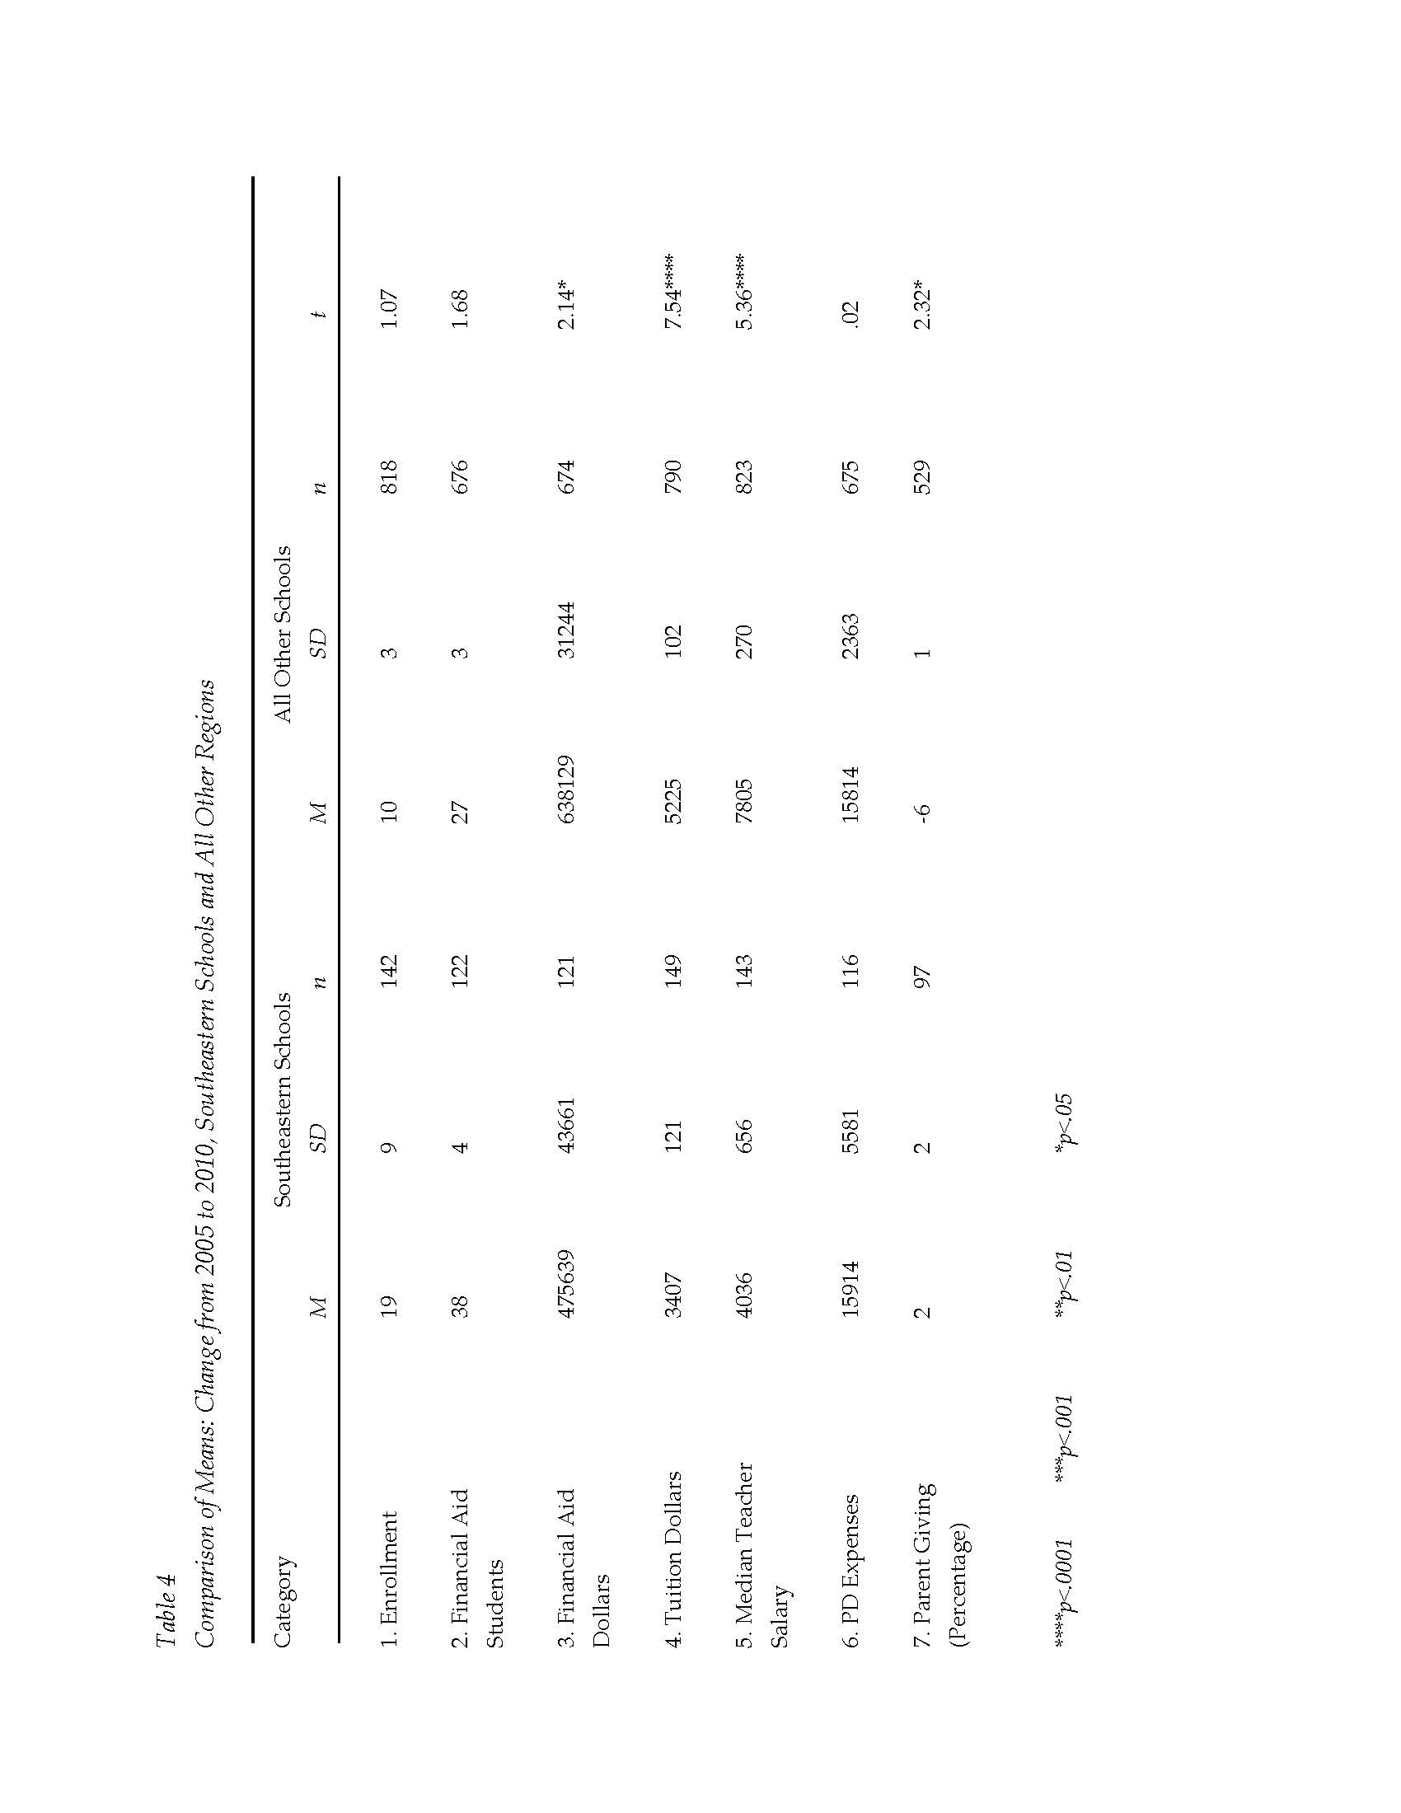

Slide 42
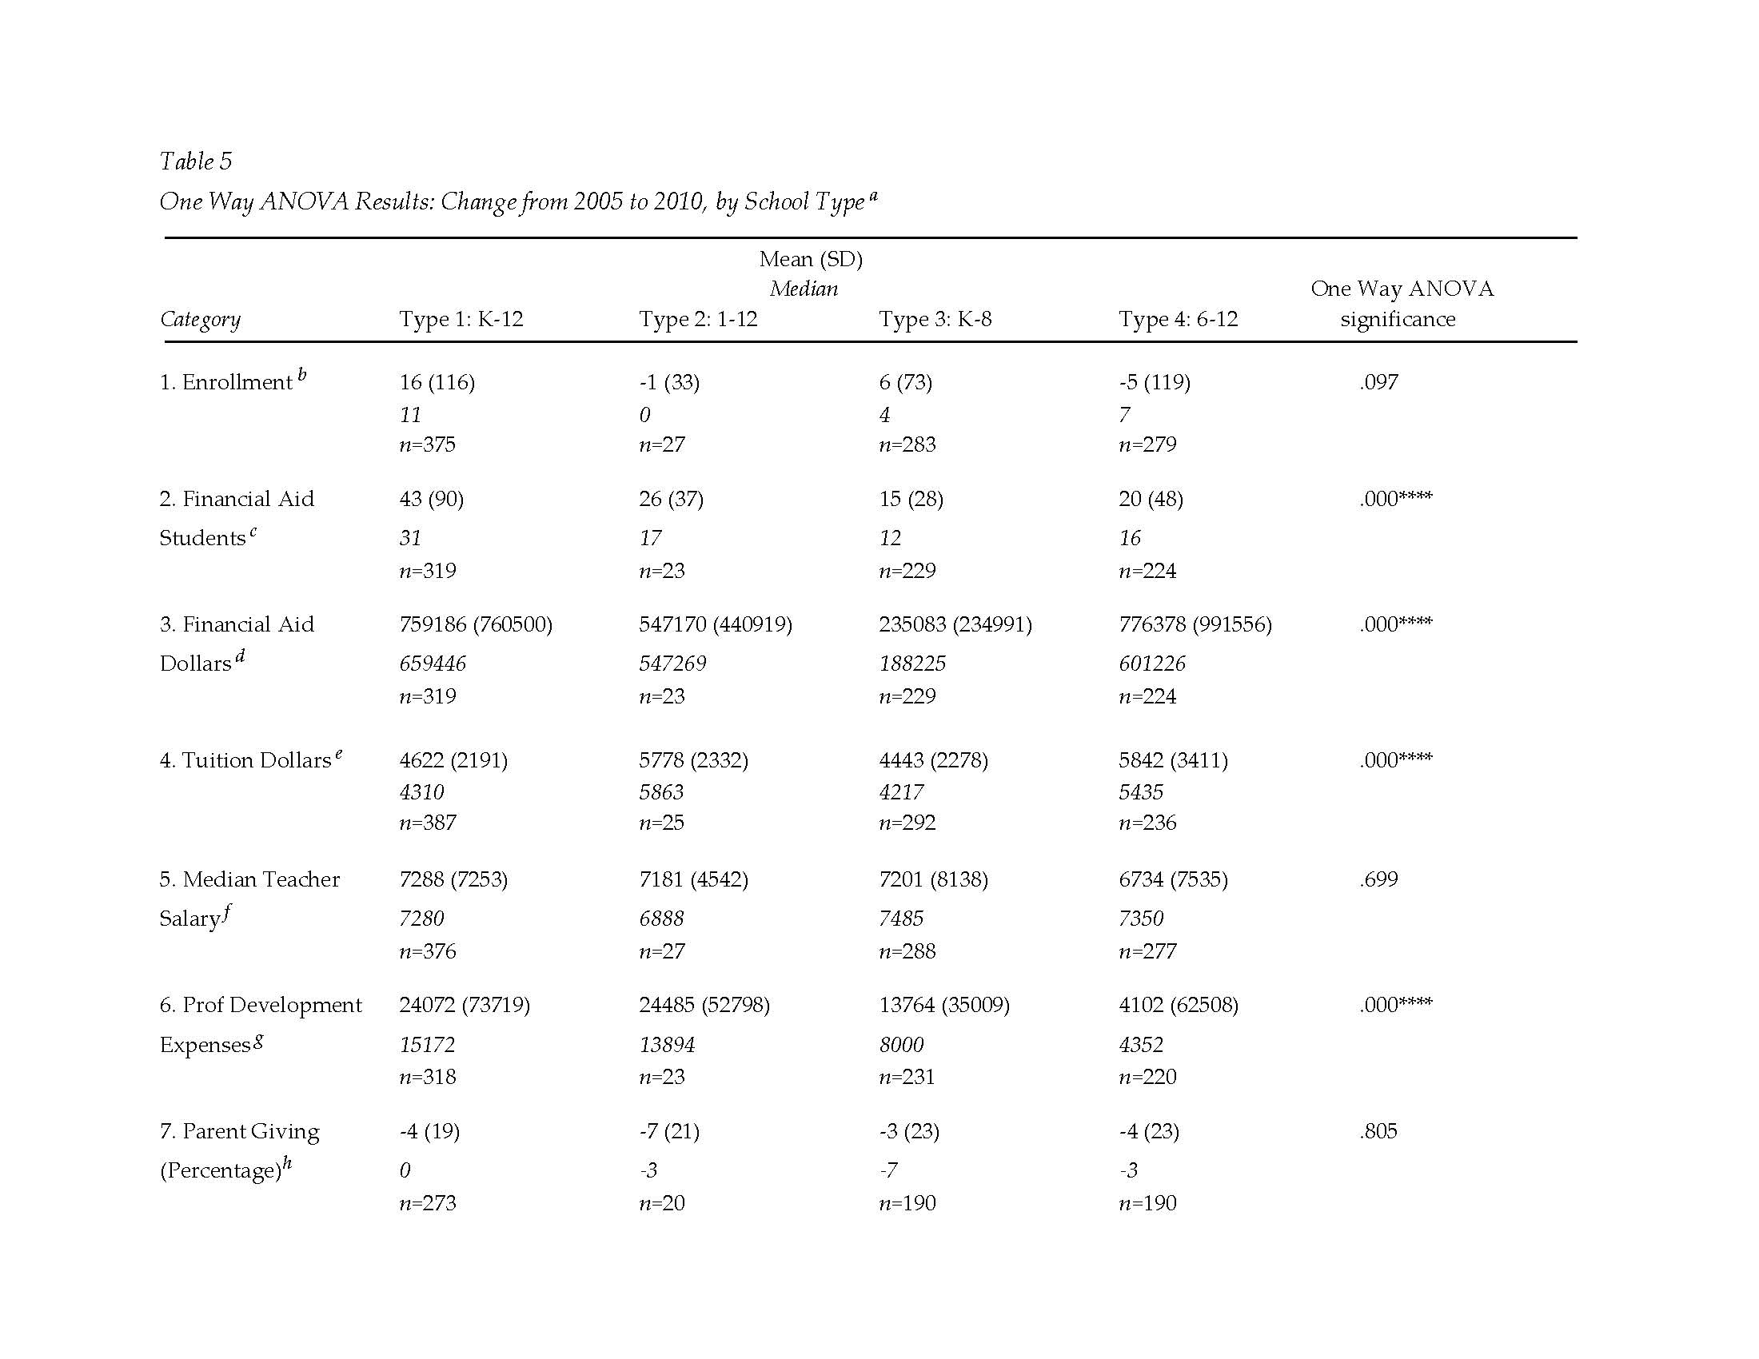

Slide 43
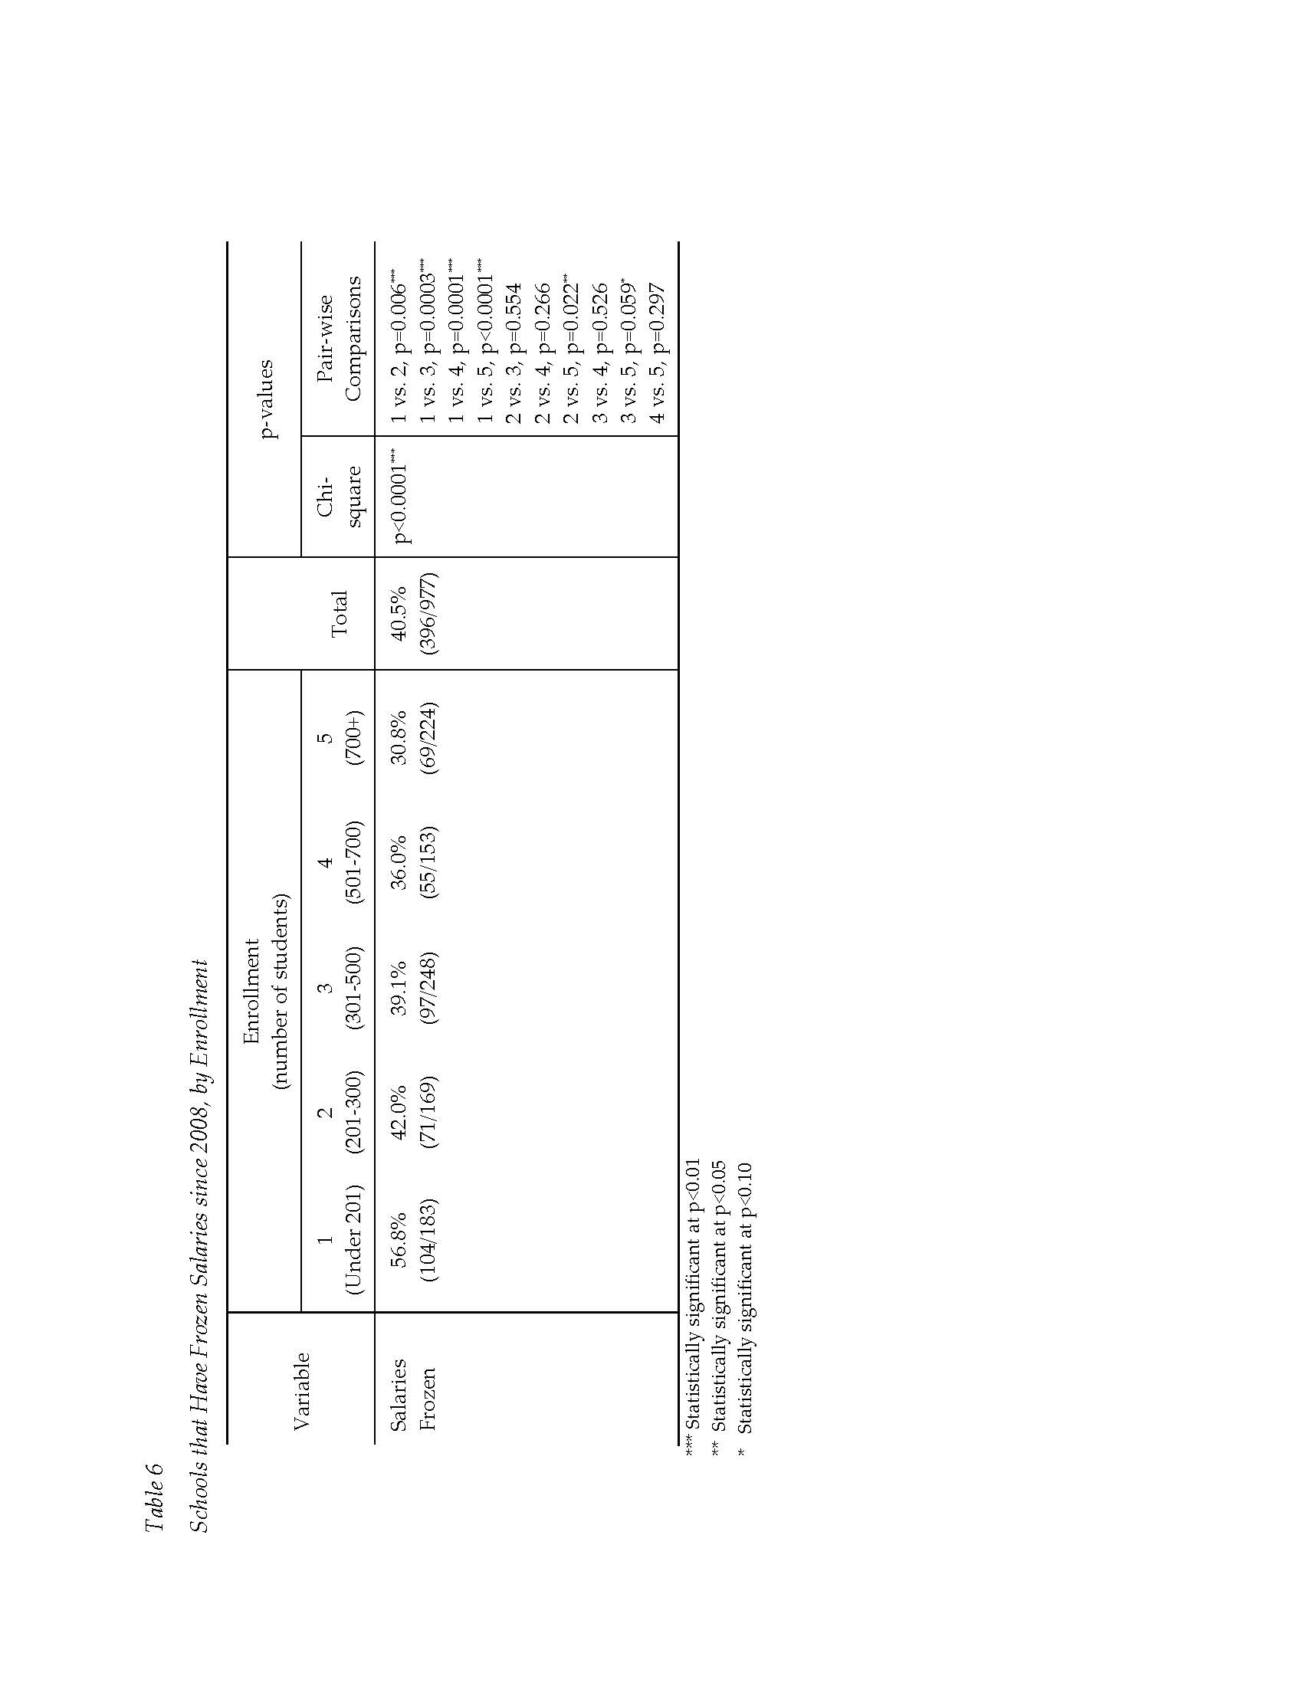

Slide 44
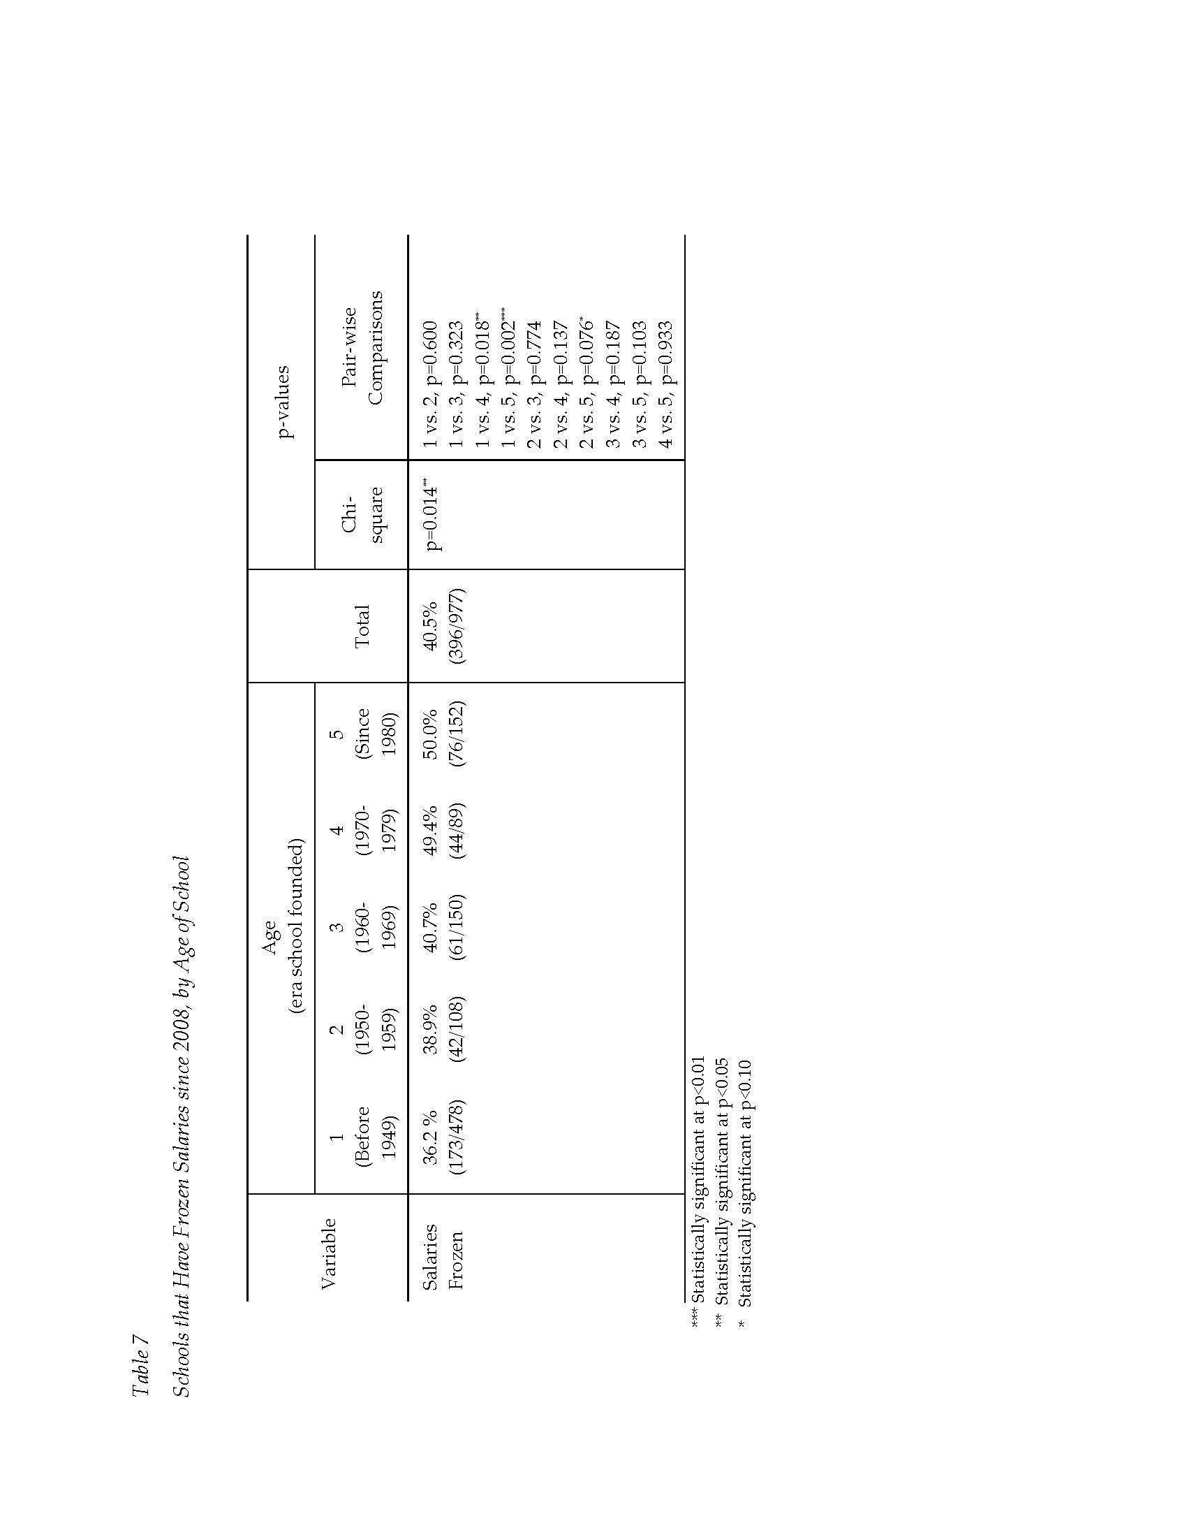

Slide 45
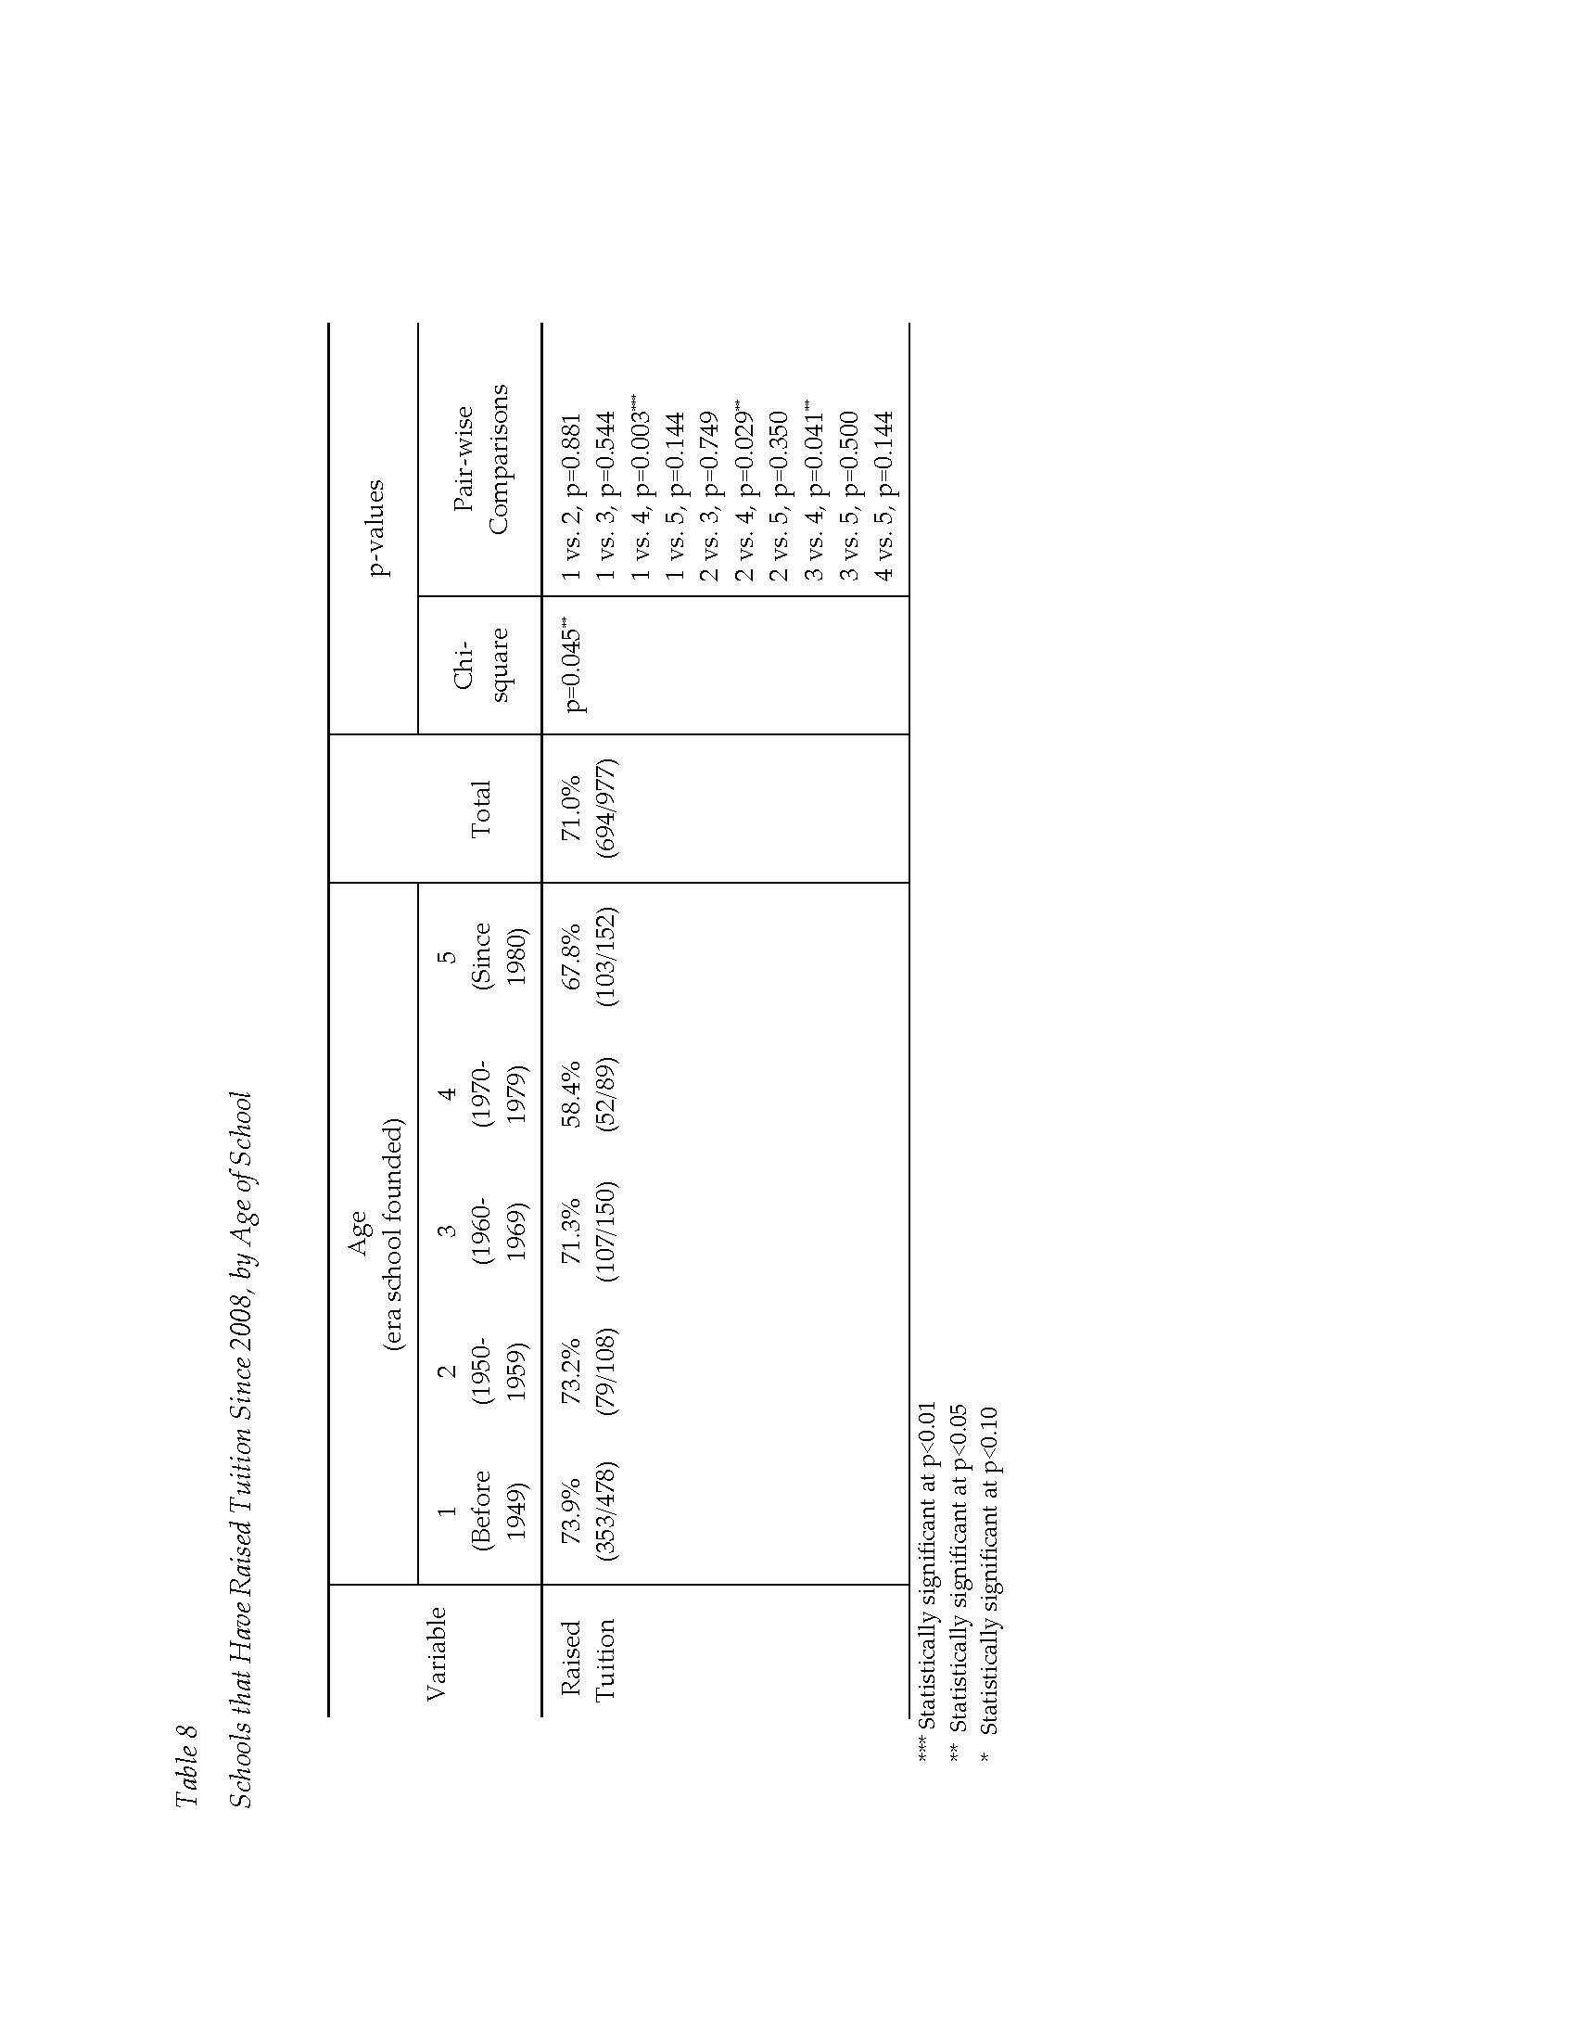

Slide 46
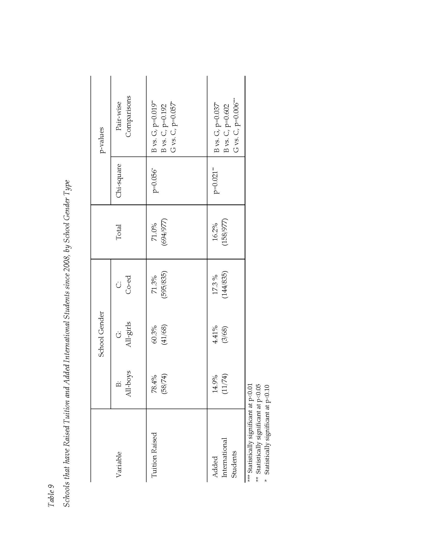

Slide 47
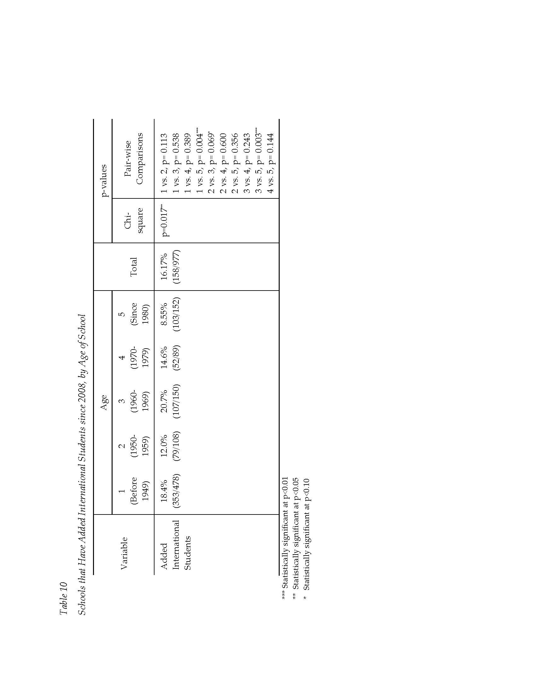

Slide 48
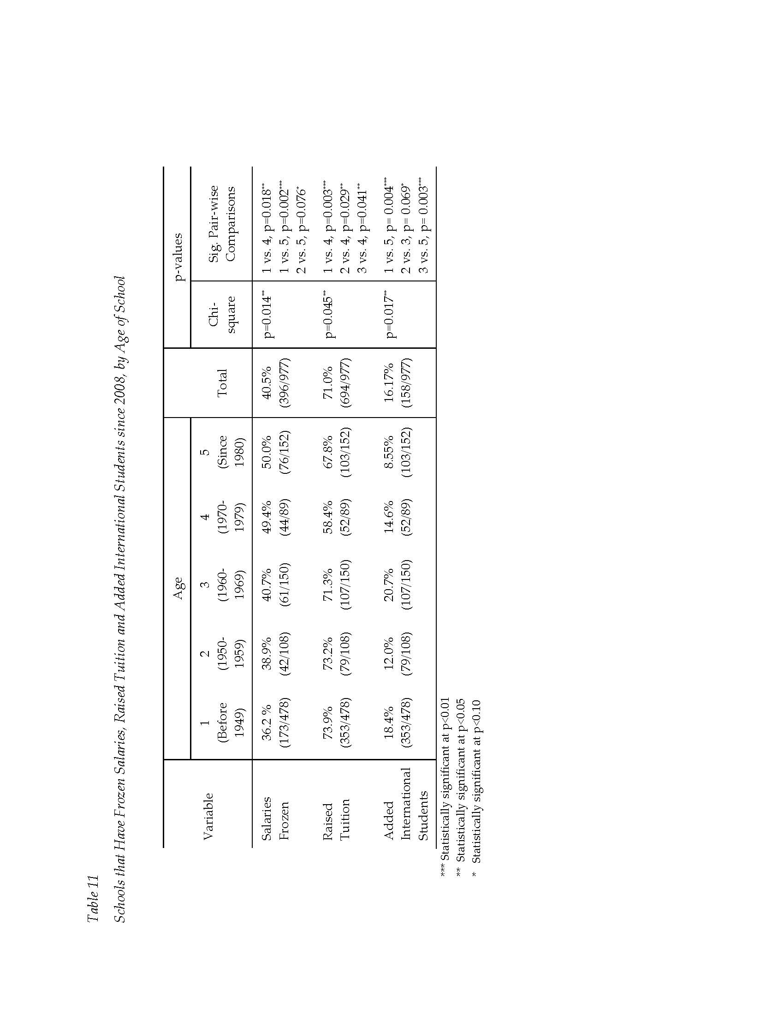

Slide 49
Extended admissions season
Context
Project Question
“We did more admissions process later in the year. We start at the same time, but we have more families coming late in the process. In July, we were still adding to our classes. Our admissions timeline is stretched out.”
(Episcopal, Division Head)
Analytical Model
Project Design
Limitations
Findings
Recommendations
Questions
ENROLLMENT TRENDS

Slide 50
Increase at other grade levels
Context
Project Question
I always in my mind had the belief that you had to build a school from the bottom up. That you had to bring them in at the lower age and then you had a high shot of keeping them. Other schools don’t get a lot in high school. That’s flipped here. We have people coming in the 8th, 9th, 10th grade because they want this experience. We don’t have to fill 60 slots in JK so that we can have 40 of them by the time they’re seniors.
(Board Member, RCDS)
Analytical Model
Project Design
Limitations
Findings
Recommendations
Questions
ENROLLMENT TRENDS

Slide 51
Professional Development
Context
Project Question
An area schools could control
Analytical Model
More efficiency in spending without cutting budgets
Project Design
Spending rose from 2005 to 2010 (p<.01 using constant dollars)
Limitations
Dip from 2009 to 2010
Findings
No differences based on gender, region, or boarding elements, but K-12 went up around $20,000 more than 6-12
Recommendations
Questions
WHERE SCHOOLS STAYED THE COURSE

Slide 52
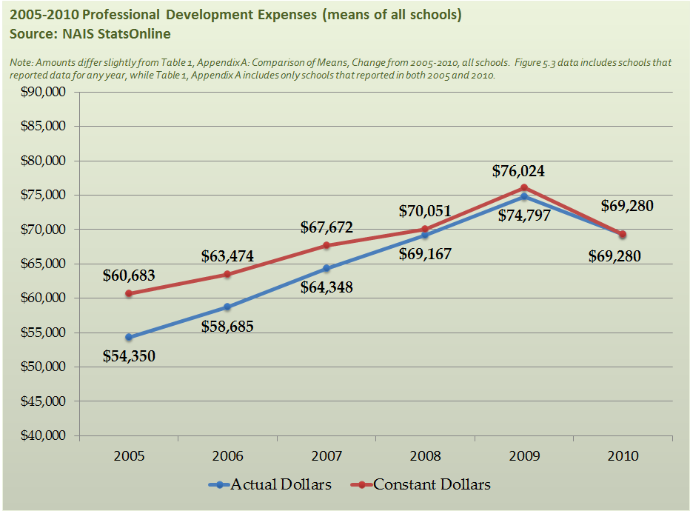
Professional Development
Context
Project Question
Analytical Model
Project Design
Limitations
Findings
Recommendations
Questions
WHERE SCHOOLS STAYED THE COURSE

Slide 53
Technology
Context
Project Question
Also an area schools could control
Analytical Model
Spending rose from 2005 to 2010 (p<.01 using constant dollars)
Project Design
No differences across school types
Limitations
Findings
Recommendations
Questions
WHERE SCHOOLS STAYED THE COURSE

Slide 54
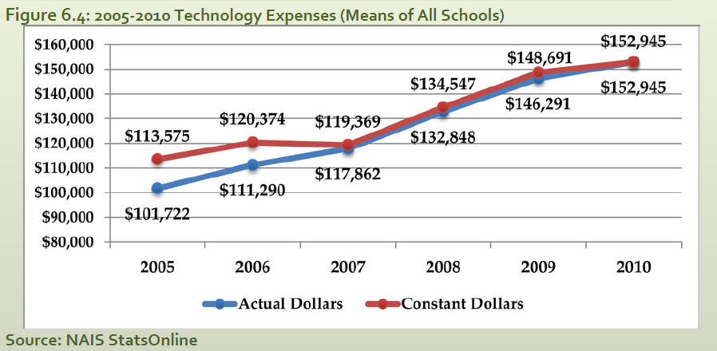
Technology
Context
Project Question
Analytical Model
Project Design
Limitations
Findings
Recommendations
Questions
WHERE SCHOOLS STAYED THE COURSE

Slide 55
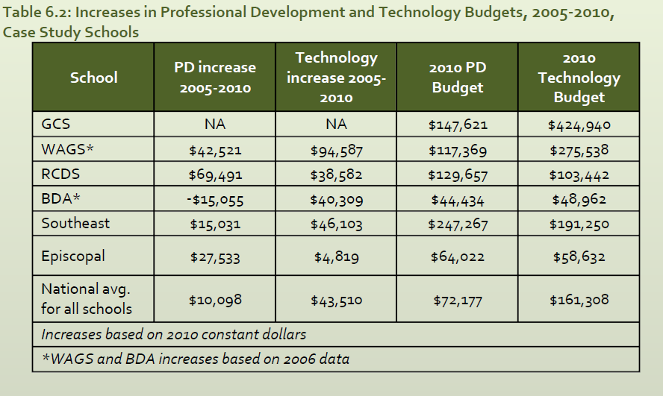
Technology
Context
Project Question
Analytical Model
Project Design
Limitations
Findings
Recommendations
Source: NAIS Database
Questions
WHERE SCHOOLS STAYED THE COURSE

Slide 56
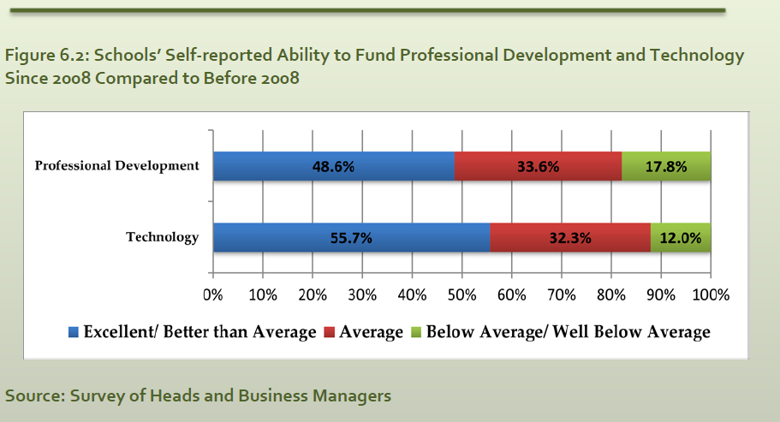

Slide 57
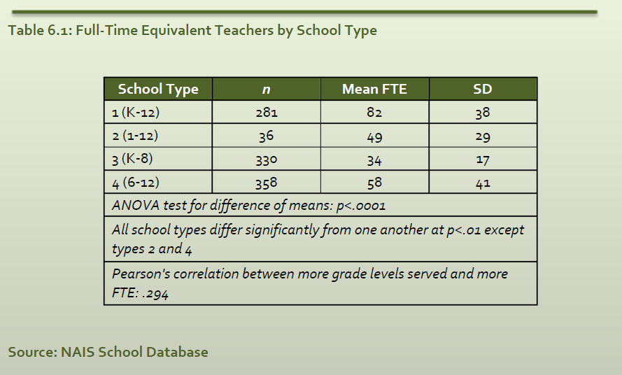

Slide 58
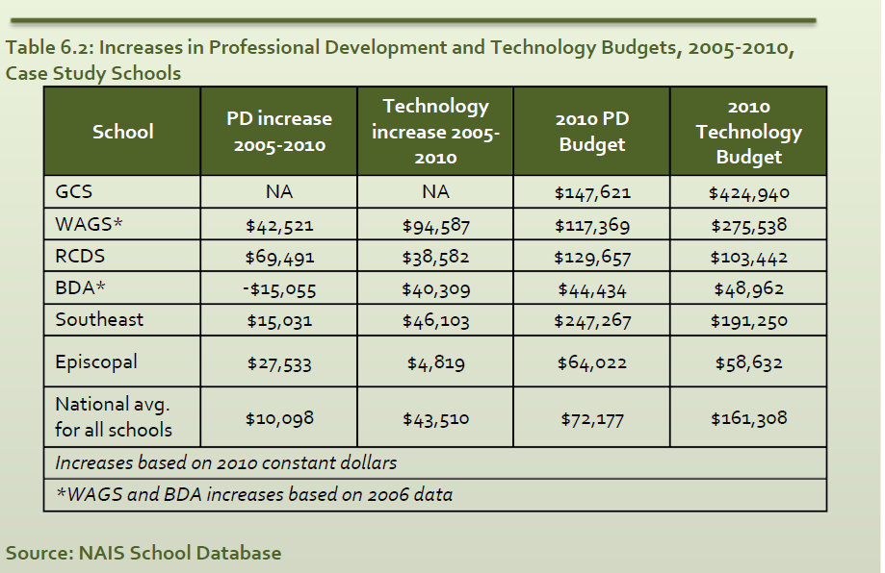

Slide 59
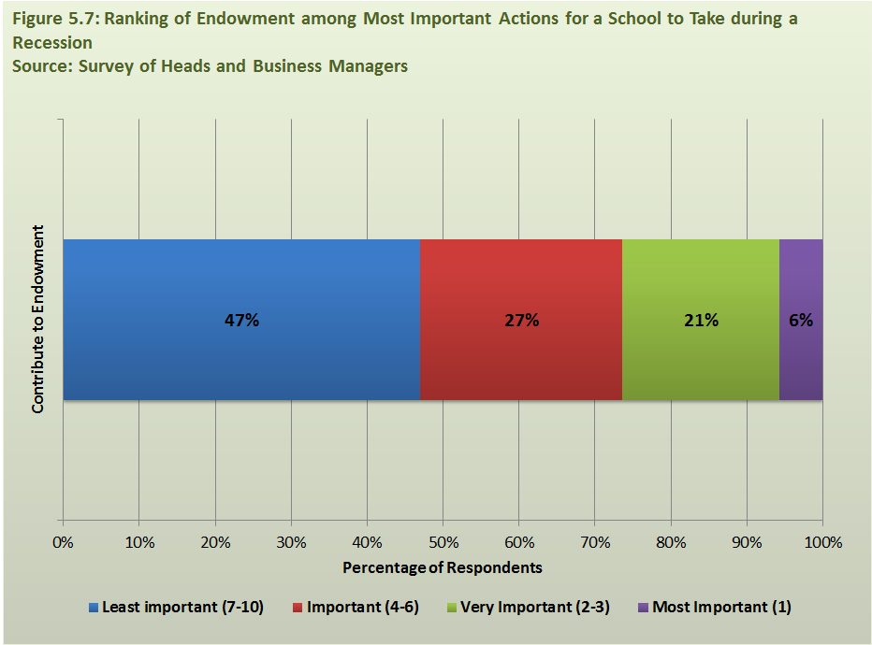
Moderate attention to endowment
Context
Project Question
Analytical Model
Project Design
Limitations
Findings
Recommendations
Questions
WHERE SCHOOLS STAYED THE COURSE

Slide 60
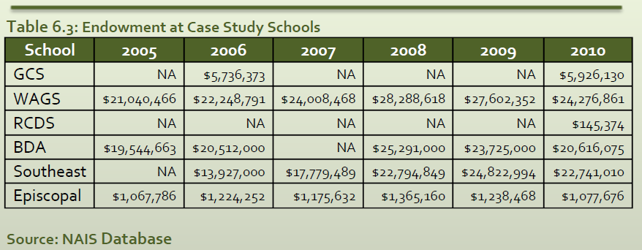
Moderate attention to endowment
Context
Project Question
Analytical Model
Project Design
Limitations
Findings
Recommendations
Questions
WHERE SCHOOLS STAYED THE COURSE

Slide 61
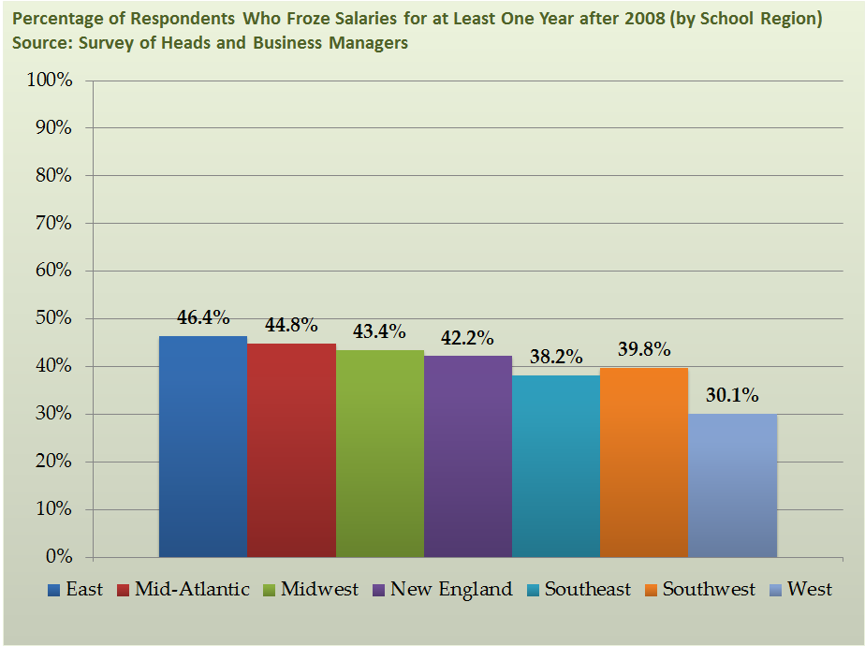
Modest Salary Increases
Context
Project Question
Analytical Model
Project Design
Limitations
Findings
Recommendations
Questions
WHERE SCHOOLS MADE ADJUSTMENTS

Slide 62
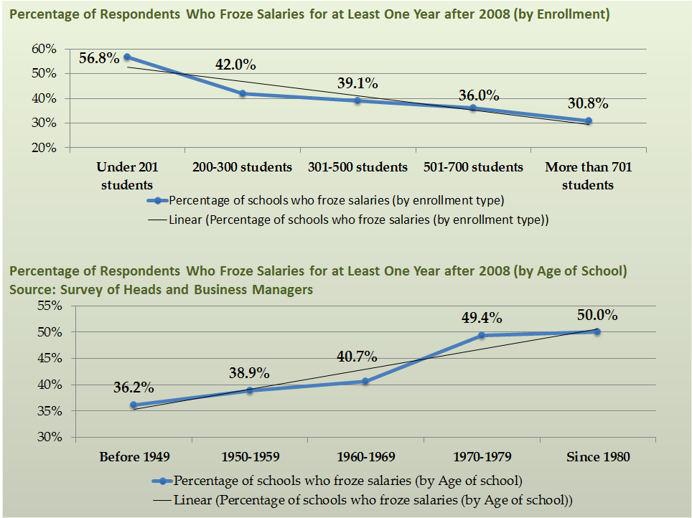
Modest Salary Increases
Context
Project Question
Analytical Model
Project Design
Limitations
Findings
Recommendations
Questions
WHERE SCHOOLS MADE ADJUSTMENTS

Slide 63
Context
Deferred physical plant maintenance
Project Question
We did cut our maintenance expenses, we did postpone the things we wanted to do in terms of physical plant, and we did reduce our staff. We outsourced our cleaning and custodial services–so our cuts were operational, but did not impact the day-to-day school.
(Business Manager, Southeast Prep)
Analytical Model
Project Design
Limitations
Findings
Recommendations
Questions
WHERE SCHOOLS MADE ADJUSTMENTS

Slide 64
Context
Increased online services
Project Question
For next year, we started partnering with an outside company that does billing and all collections. For us, it is not just from the finance standpoint of, “We've got to figure out a way to get our money and get it in on time,” but also to give families online capability and options. People tell me all the time that this is the only check they write–they pay all their bills online, but still have to come in here.
(Business Manager, Episcopal)
Analytical Model
Project Design
Limitations
Findings
Recommendations
Questions
WHERE SCHOOLS MADE ADJUSTMENTS

Slide 65
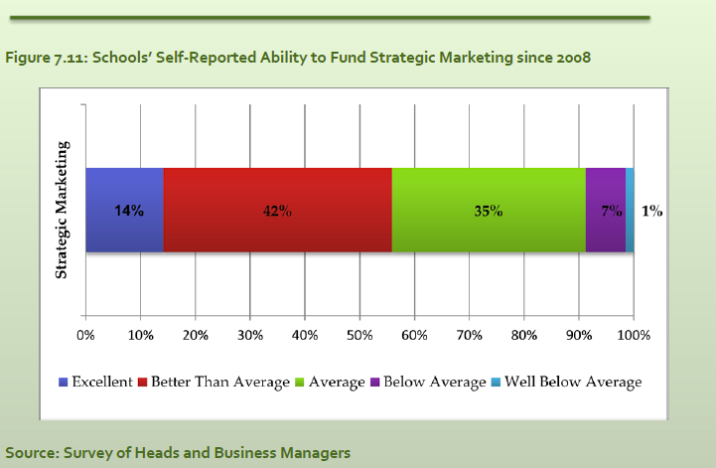
Context
Re-examined marketing
Project Question
Analytical Model
Project Design
Limitations
Findings
Recommendations
Questions
WHERE SCHOOLS MADE ADJUSTMENTS

Slide 66
Context
Re-examined parent organizations
Project Question
New Model
1. Community building
2. Retention and marketing
3. Financial support
Analytical Model
Old Model
1. Financial support
2. Teacher appreciation
Project Design
Limitations
Findings
Recommendations
Questions
WHERE SCHOOLS MADE ADJUSTMENTS

Slide 67
Context
Increased accountability
Project Question
“They've been more specific about what each department is spending. They are asking what we really need, not telling you that you cannot have it; they’re being more prudent in making sure the money goes back to the students.”
(Teacher, Wooded Acres)
Analytical Model
Project Design
Limitations
Findings
Recommendations
Questions
WHERE SCHOOLS MADE ADJUSTMENTS

Slide 69
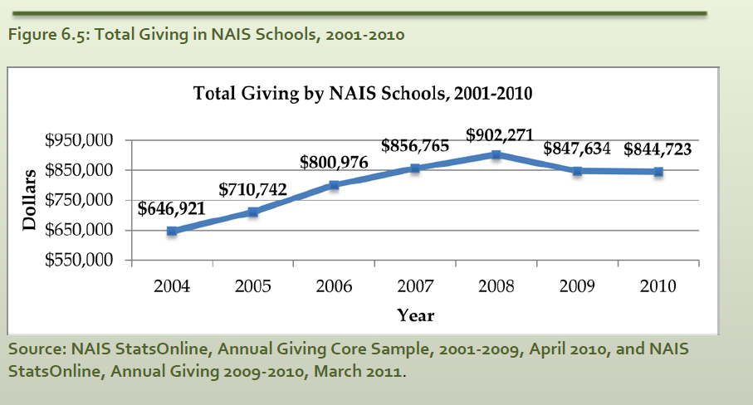

Slide 70
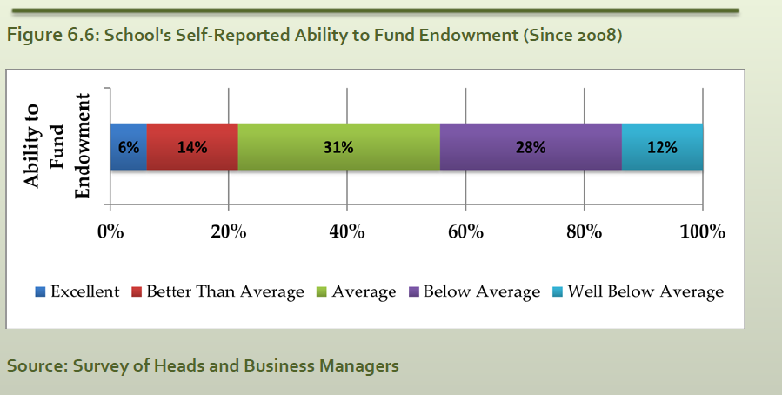

Slide 71
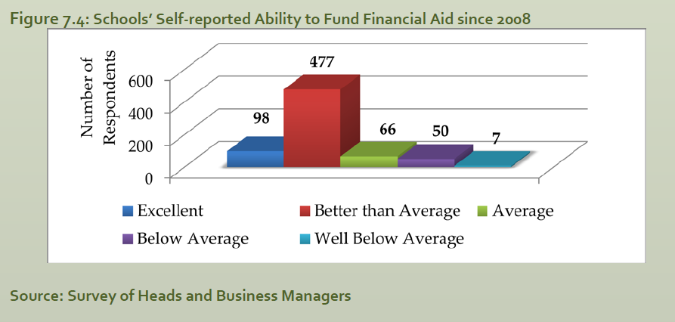

Slide 72
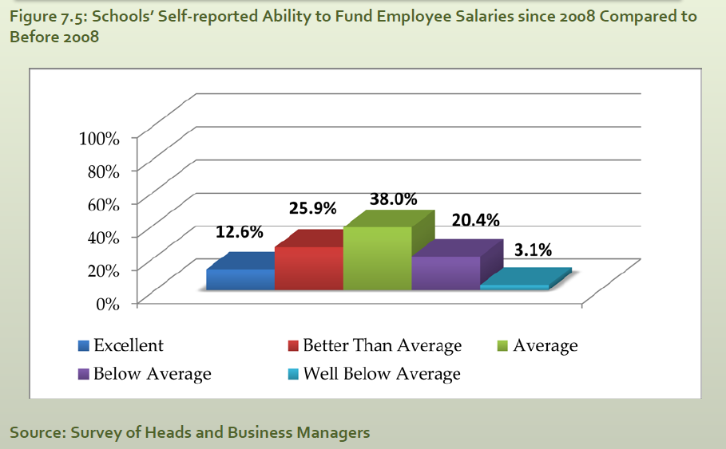

Slide 73
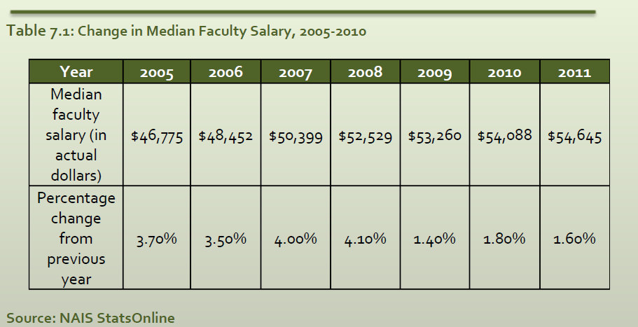

Slide 74
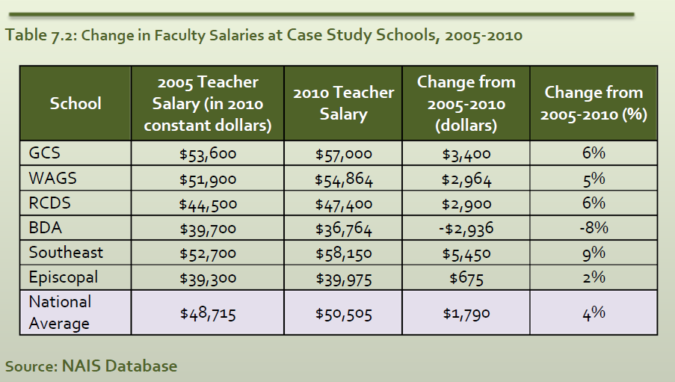

Slide 75
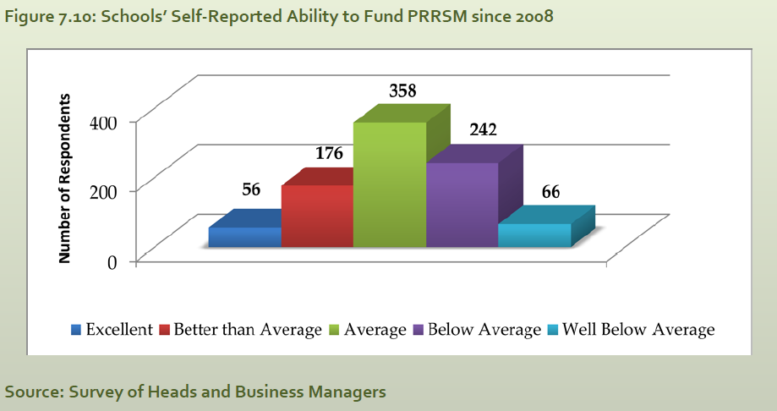

Slide 76
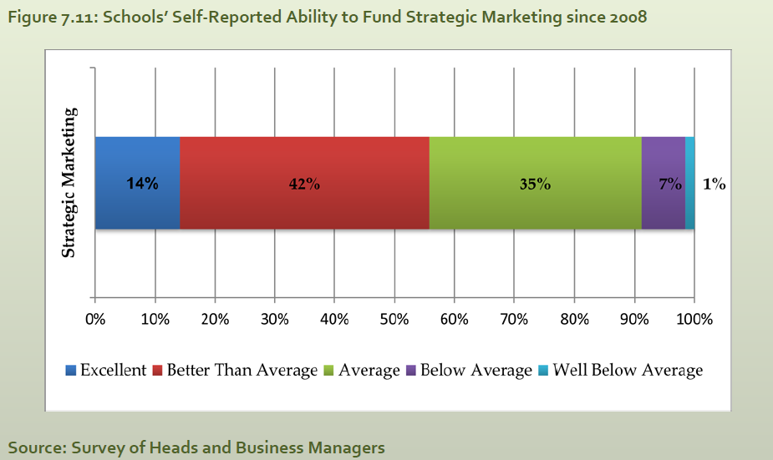

Slide 77
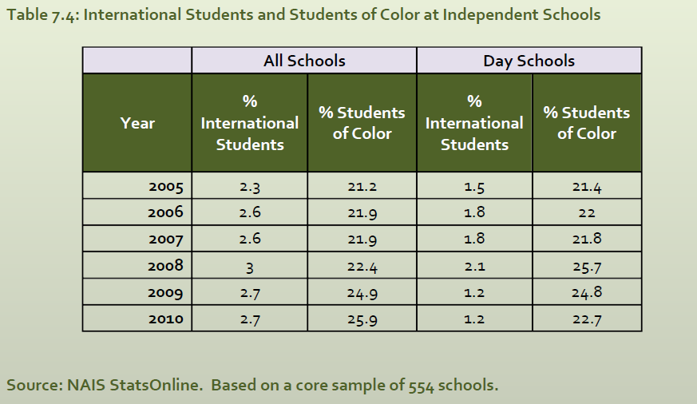

Slide 78
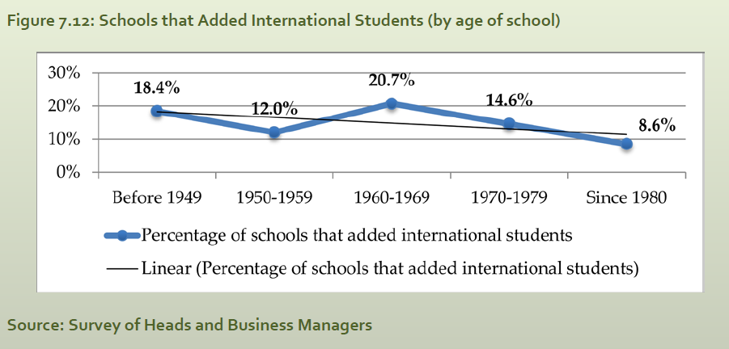

Slide 79
Database: Self-reported
Reliability: Constant dollars vs. actual dollars
Validity: Not likely to have been affected by common threats (history or maturation effects)
Context
Project Question
Survey:
Reliability: Incomplete responses
Related reliability: questions designed to connect to analytical model, and working with Sr. Director of Academic Research attempted to address face-validity
Internal validity: self-selection bias
External validity: distinct schools (988 total; 484-988)
Analytical Model
Project Design
Limitations
Findings
Site visits: Generalizability
Threat to internal validity- we both work in independent schools and may have pre-conceptions
Recommendations
Questions

